Slide 1

Project 1
Real Estate
Understanding the Influences upon Property Prices in Melbourne
Presented by:
Kali Notaras
Keerthi Chippa
Basudeb GhosH
Aayush Gupta
Christopher Banh

Slide 2


Project Description & Outline
Melbourne Property Price Insights
For Buyers:
For Sellers:
Key attributes influencing Property Prices
Insights per Living Demographic
Refined pricing estimates
Evaluate the performance of Melbourne’s top real estate agencies.

Slide 3
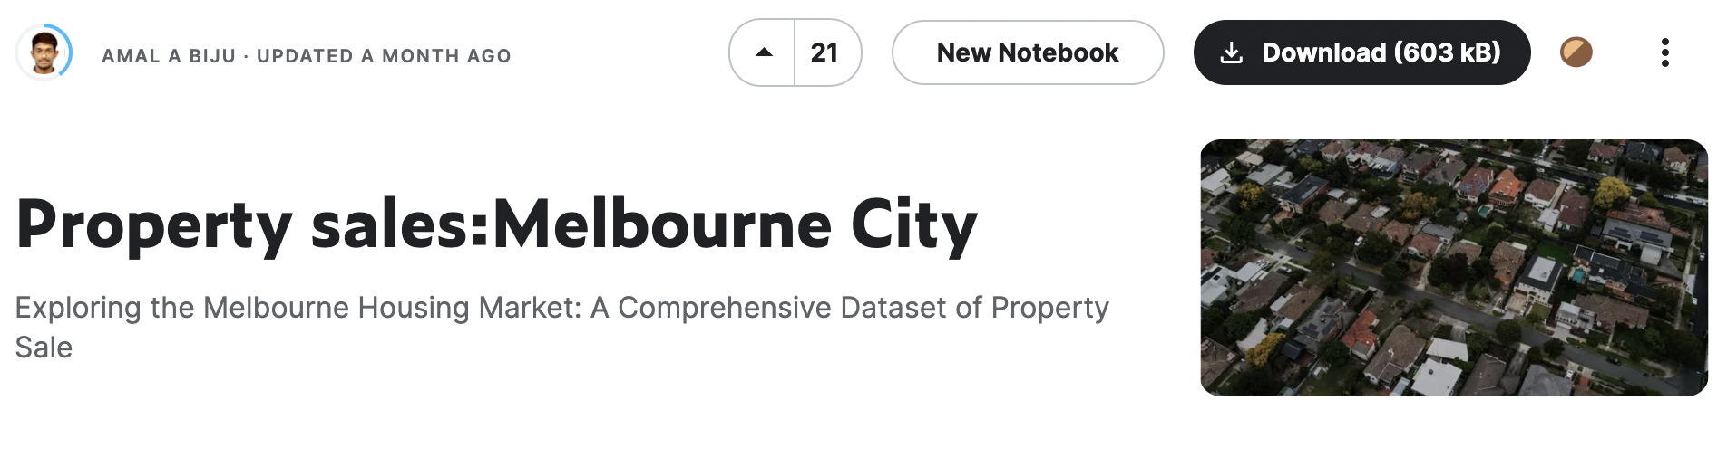
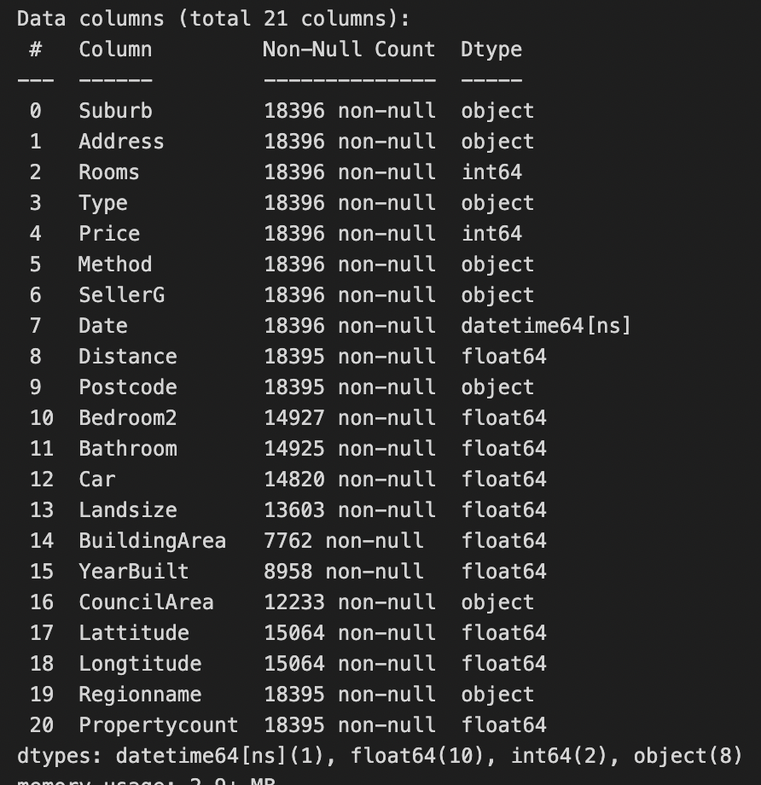
Dataset & Initial Data Cleaning
Source: Data generated by Biju, A.A. (2023). Property sales:Melbourne City.
Accessed on 4 April 2023. URL: https://www.kaggle.com/datasets/amalab182/property-salesmelbourne-city
Cleaned Dataset
21 Columns
18,396 Rows

Slide 4
QUESTION 1.
What are the main influences on Property Prices in Melbourne?

Slide 5
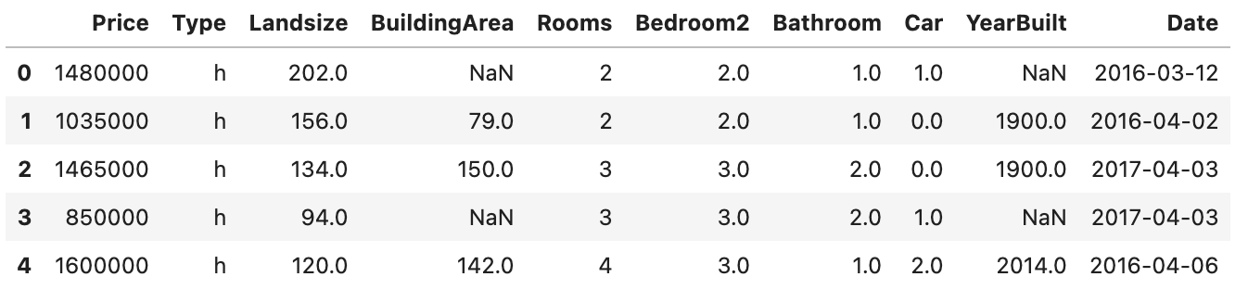
QUESTION 1.
Data Exploration & Cleaning
Dependent Variable
Price
Number of Bedrooms
Number of Bathrooms
Parking Spots
Year Built
Date of Sale
Independent Variables
Property Type
Land Size
Building Size
Rooms

Slide 6
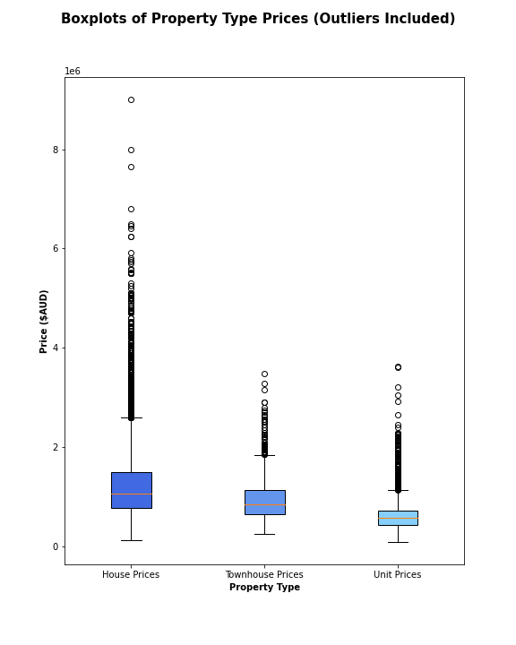
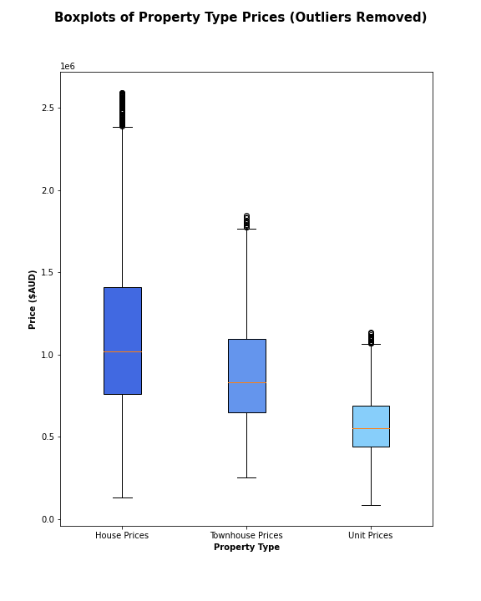
QUESTION 1.
Data Analysis: Property Type

Slide 7
QUESTION 1.
Conclusion
Results
Assumptions
Hypothesis Testing
T-Test

Slide 8
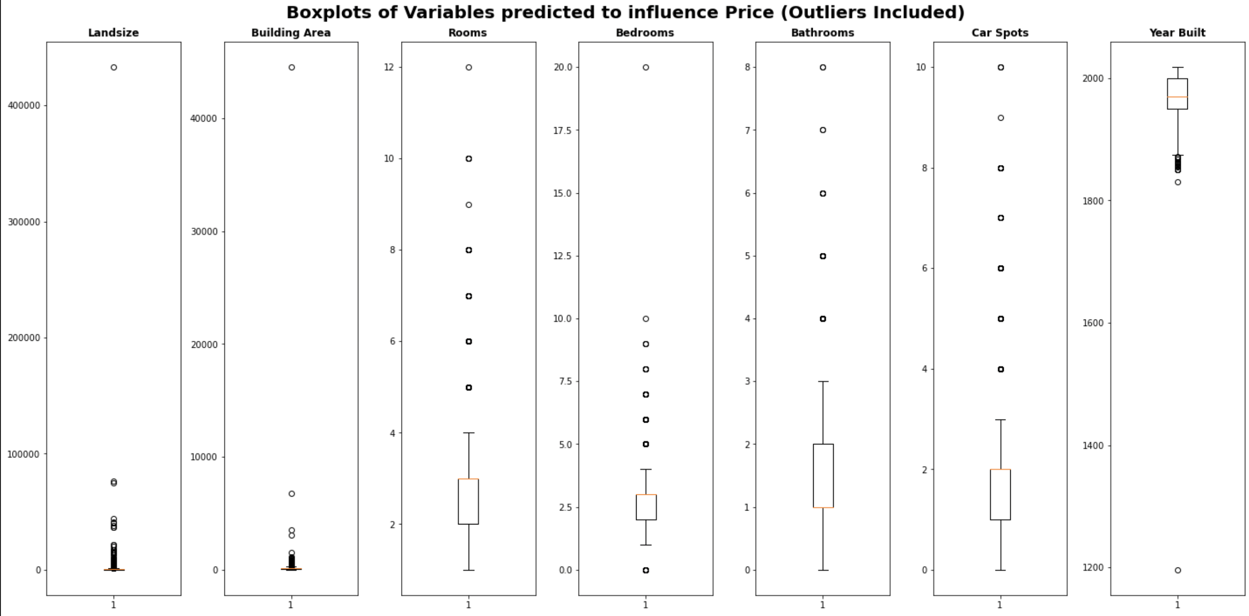
QUESTION 1.
Data Analysis: Dependent Nominal Variables

Slide 9
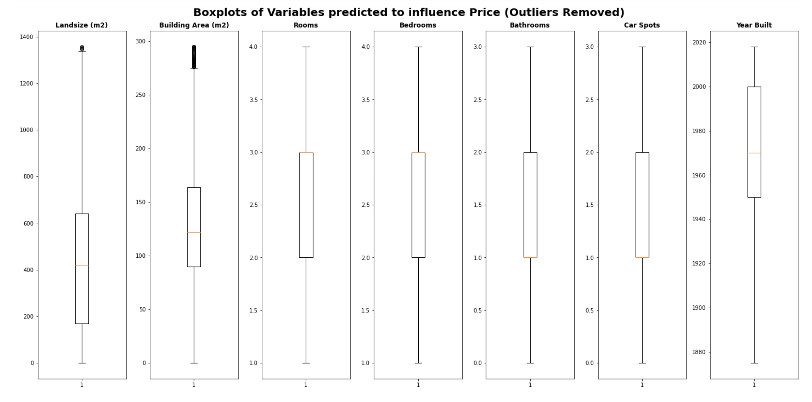
QUESTION 1.
Data Analysis: Dependent Nominal Variables

Slide 10
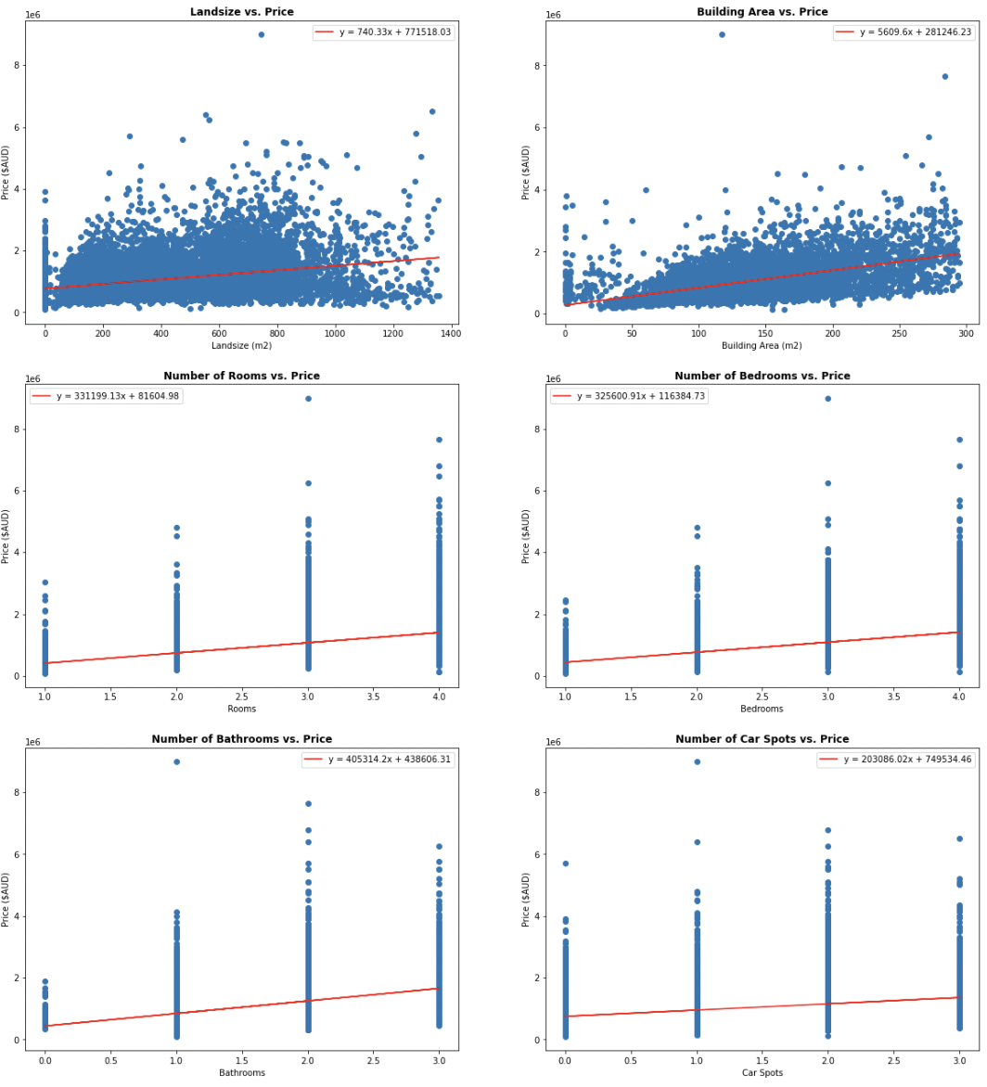
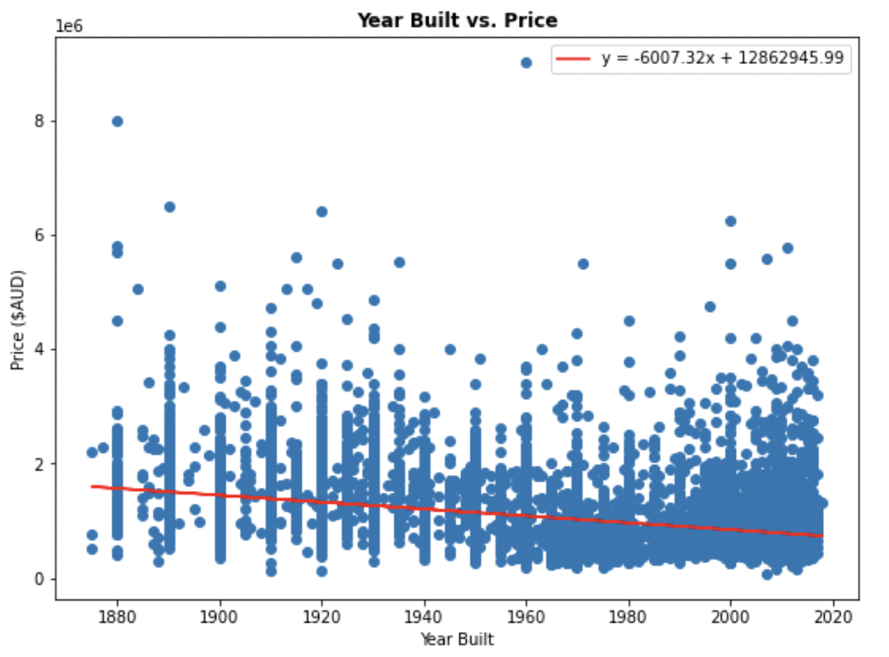
QUESTION 1.
Data Analysis: Dependent Nominal Variables
Continuous Variables
Ordinal Variables

Slide 11
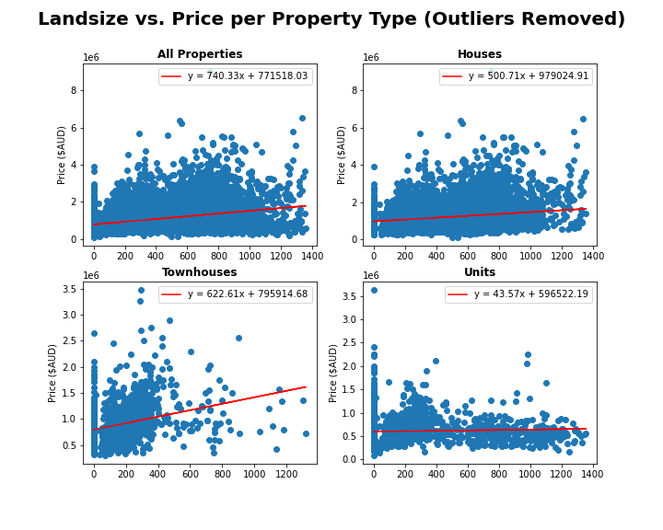
QUESTION 1.
Data Analysis: Dependent Nominal Variables
Correlation Values
All
House
Townhouse
Unit
0.339
0181
0.280
0.048

Slide 12
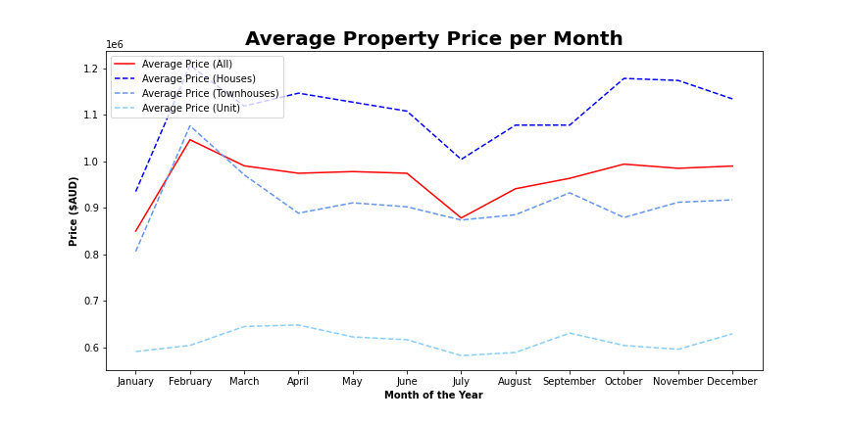
QUESTION 1.
Data Analysis: Date of Sale

Slide 13
QUESTION 2.
Looking to buy in Melbourne? What location is best for you and your bank account

Slide 14
Q2: Looking to buy in Melbourne? What location is best for you and your bank account
Parameters Used:
Distance from CBD
Location (Latitude, Longitude, Suburb, Region)
Target Demographics – Large Families, Small Families, Couples, and Singles.
Property Type – Unit/Appartment (u), Townhouse (t), House (h)

Slide 15
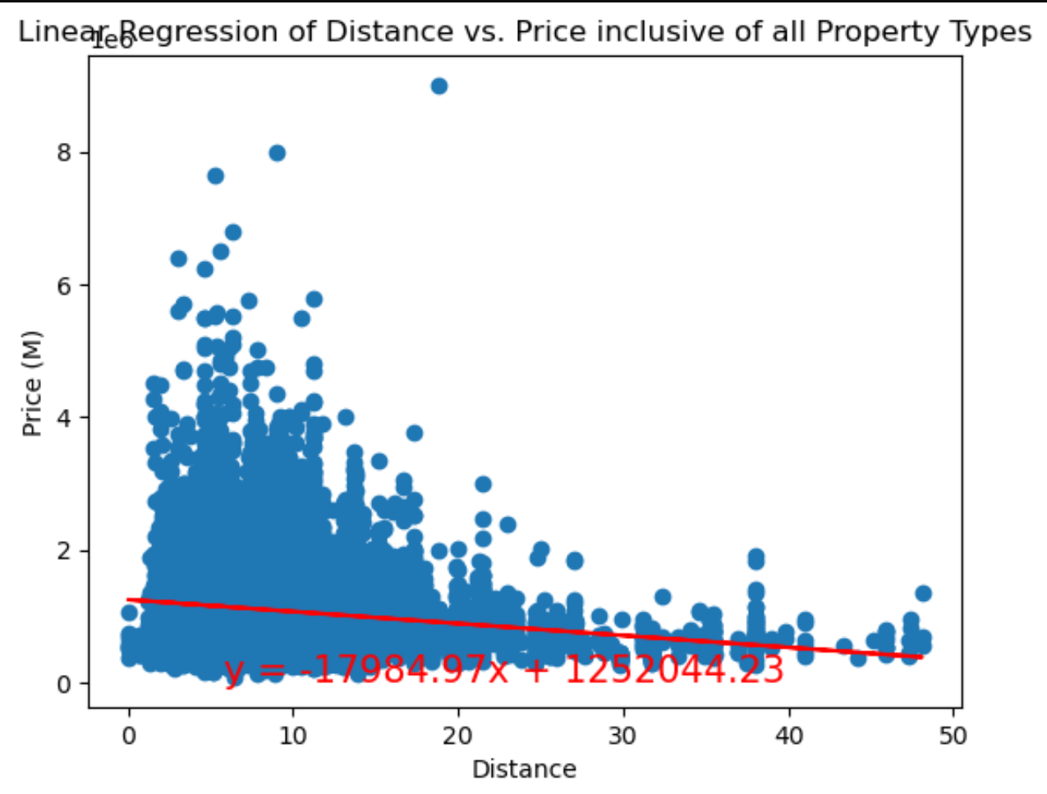
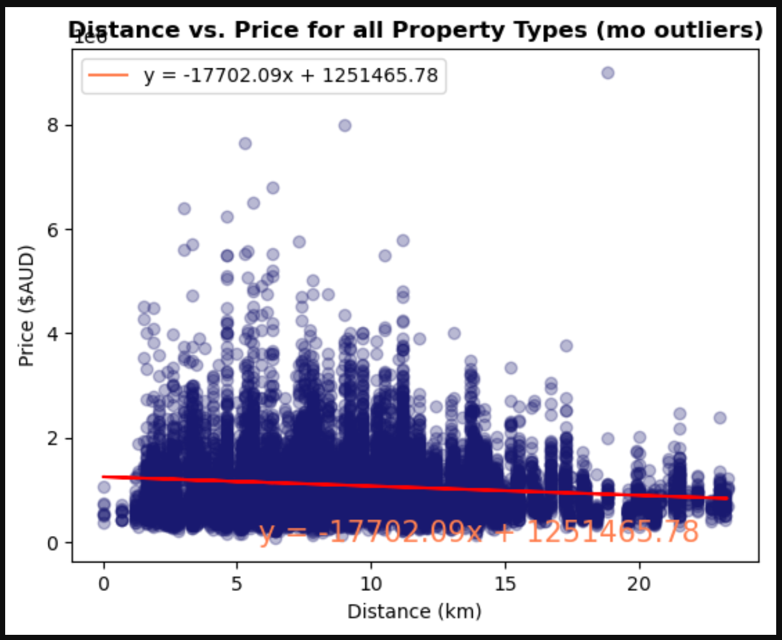
All Properties Linear Regression
Notes:
$200K off price, reading a bit high for the average of 1.52 mil, what were these properties, developer, child care, residential business old age home, student dorm accommodation.

Slide 16
Where to Look? What’s it going to Cost?
 | Average Price
All Property | $ 987,647.97
House | $ 1,139,106.00
Townhouse | $ 890,334.70
Unit/Appartment | $ 570,810.00
Property Type | Suburb | Min Avg Price
House | Bacchus Marsh | 285000
Townhouse | Craigieburn | 357000
Unit/Appartment | Jacana | 280000
Property_Type | Region | Min Avg Price
House | Western Victoria | $ 397,391.00
Townhouse | Eastern Victoria | $ 595,000.00
Unit/Appartment | Eastern Victoria | $ 461,333.30
Notes:
Bacchus Marsh – 55 km from the city (1hr 14 min or 56km (49 min) Geelong
Craigieburn – 30km from the city 1hr min commute
Jacana – 18.5km city (50 min commute
- BlackRock House Avg1.92 mil, Mount Albert 1.90 mil, Ivanhoe East 1.89 mil
Townhouse in Deepdene – 1.68 mil, Caulfield1.6 mil, Canterbury 1.59 mil
Units – McKinnon 960K, Doncaster East 899K, Glen Waverley 866K

Slide 17
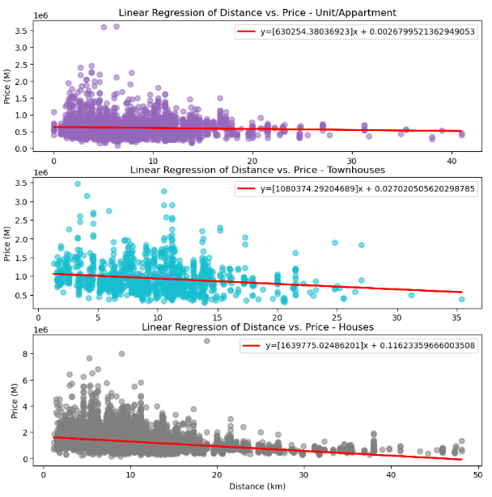
Linear Regression by Property Type
Linear Regression by Property Type
Units = y= 630253.380x + 0.0267995
Townhouses = y = 1080374.292x + 0.02702
Houses = y= 1639775.02486x + 0.116233

Slide 18
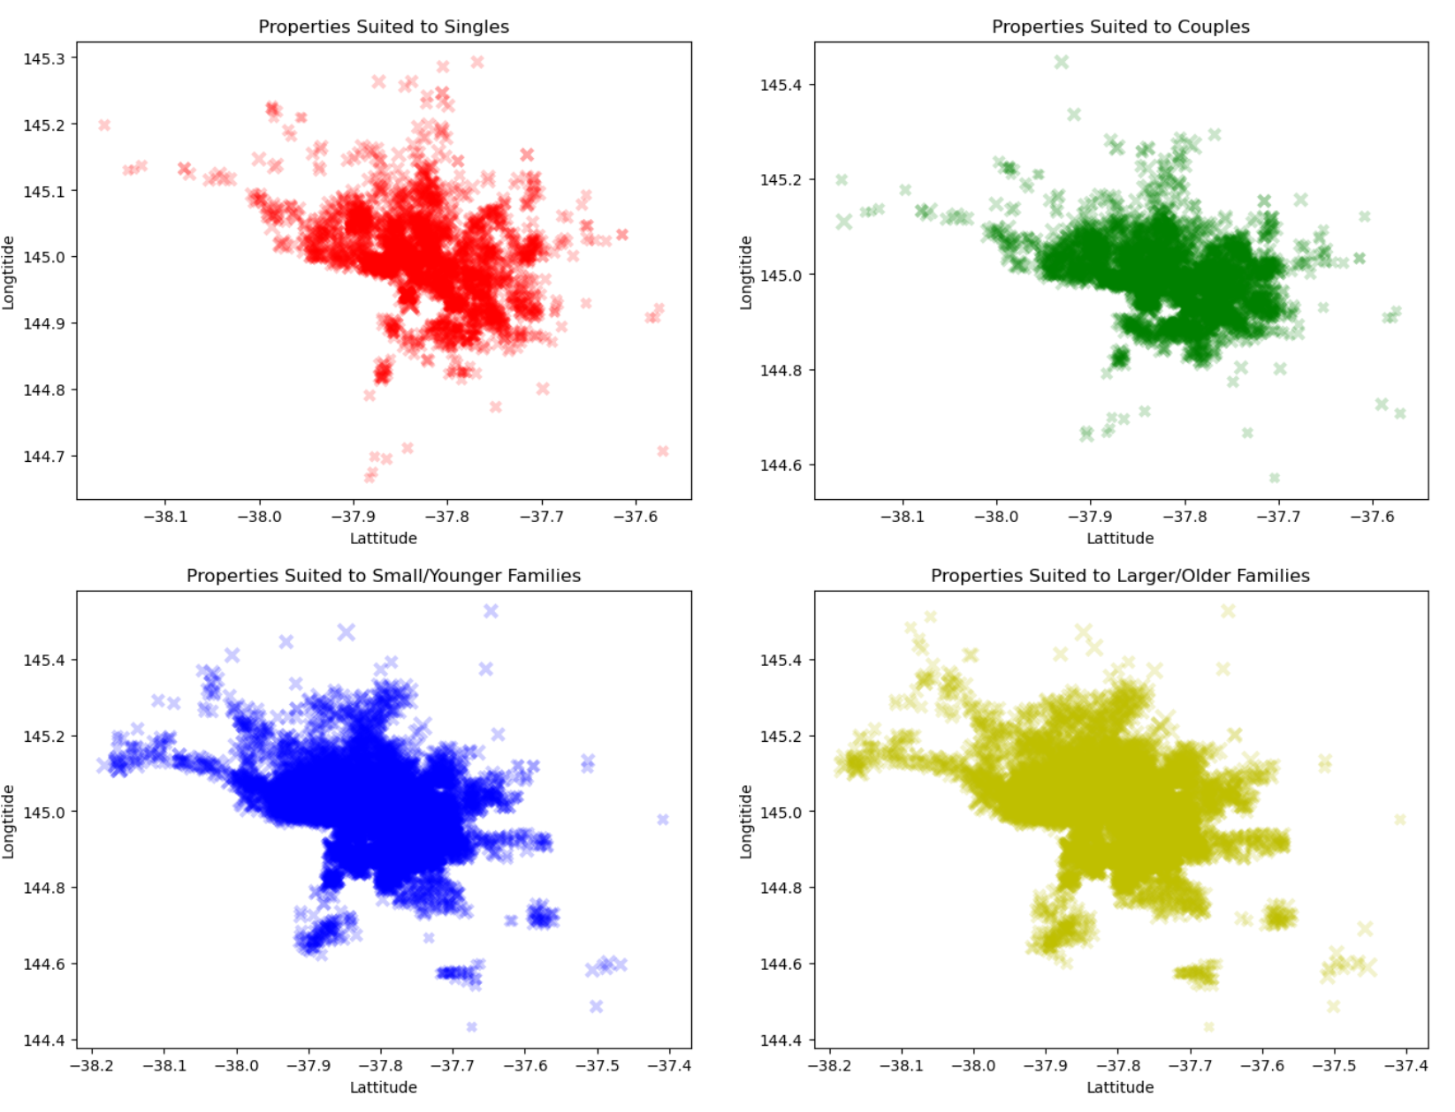
Density of Properties Across the Region
Single – Looking for a unit or townhouse, typically properties with 2 or less bedrooms.
Couples – Looking for a unit, townhouse or small house, with 2 bedrooms.
Small Families – Looking for a unit, townhouse or small house, with 2 or 3 bedrooms.
Large Families – Looking for a house, with 3 or more bedrooms.
Notes:
Discuss demographics, fur babies, bikes, space, to explain the spread.

Slide 19
QUESTION 3.
Looking to sell in Melbourne? Which real estate agency will get you the best value?

Slide 20
QUESTION 3.
Parameters Used:
Number of properties sold
Performance of price above average (Z-score average)
Location-based performance
Method of Sale

Slide 21
QUESTION 3

Slide 22
Final summary of implications
(Enter points for conclusion)

